Slide 1
WHY
Business Challenges
Use Case Description
KPIs Impacted
High Administrative Overload
Slow Patient Service and Delayed Response Times
Fragmented Communication across the Channels
Inconsistent and Error-Prone Documentation.
Rising Operational Costs.
25–35% decrease in time spent on documentation, emails, referrals, and follow‑ups.
40–60% reduction in errors or missing clinical details
20–30% improvement in turnaround time for patient queries, appointment scheduling, and triage
The Medical AI Assistant aims to streamline clinical workflows by automating routine administrative and documentation tasks using Microsoft 365 Copilot, Copilot Studio, and Power Platform. Healthcare providers currently spend a significant portion of their time on manual data entry, patient communication, and paperwork—leading to slower service, increased operational costs, and clinician burnout.
AI-Enabled Clinical Workflow & Patient Interaction Automation
Business Impact
Reduced Administrative Burden
Faster and More Efficient Patient Service
Improved Quality and Accuracy of Medical Documentation
Higher Patient Satisfaction and Engagement
Operational Cost Savings
HOW
WHO
Functional Solution
Technical Solution
Stakeholders
Inbound Patient & Staff Interactions
AI Understanding & Intent Processing (Copilot + LLM Layer).
Automated Clinical Documentation
Appointment, Referral & Coordination Automation
Virtual Patient Assistant (Copilot Studio Bot)
Internal Clinical Assistant (For Hospital Staff)
Decision Support (Non-Diagnostic)
Backend Data & Workflow Integration
M365 Copilot – Summaries, drafting, knowledge answers
Copilot Studio – Virtual assistant, orchestration
Power Platform (Power Automate + Power Apps + AI Builder) – Workflows, apps, extraction
Azure OpenAI – LLM intelligence layer
Microsoft Fabric – Data/analytics
Microsoft Entra ID – Security & identity
Clinicians
Nurses
Hospital Management
IT/Tech Teams
Patients
Labs/Radiology/Pharmacy
Microsoft Technology Teams

Slide 2
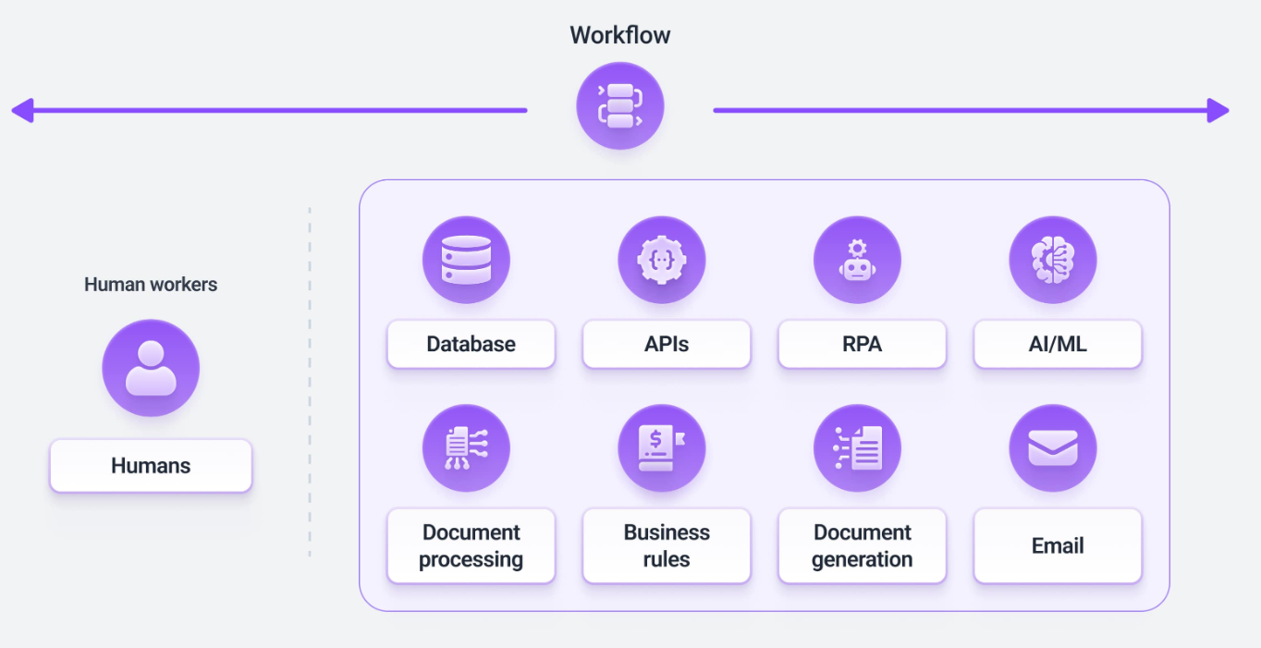
Functional Solution + AI-Human Chemistry

Slide 3
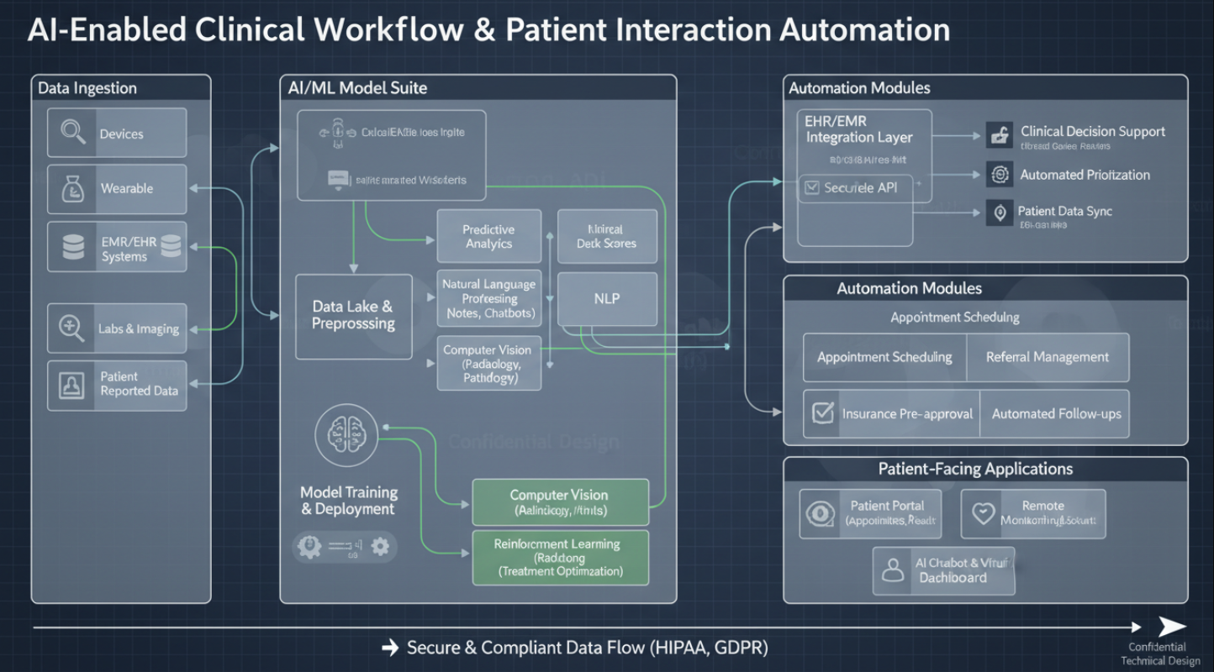
Technical Solution
technologies

